Slide 1

UNIX - Fundamentals
7
Simple Filters
9
SED
5
The shell
cmp comm diff head and tail …
Inserting
Updating
Deleting
RegEx….
1
UNIX Intro
3
Unix File System
Pattern matching
Escaping Redirecting…
The UNIX OS
The Linux OS
Features of Unix
The file
pwd and cd
mkdir
ls and cp ..
Shell Programming
8
GREP
10
6
The Processes
The character class
The *
The Dot…
condition eval
loops
read
exit status
4
Vi/Vim editors
ps nohup at and batch
2
Unix Commands
Input mode
Saving text
Aborting…
command basics
man
echo
printf …
Biz Nigatu
Software Engineer and Instructor
reckonedforce.com
@bizNigatu

Slide 2
Section 1 – UNIX Fundamentals
Why an operating system?
How a Program Runs on a Computer?
What is Unix Kernel and the Shell?
What are some of the common Shells?
History of Unix
Common Unix Shells
Layers of Unix
History of Linux
Different distributions of Linux
Myths vs Facts about Unix
Difference between Unix and Linux
Structure of /etc/passwd
How to record your Labs?

Slide 3

Why an Operating System (OS)
OS interacts with hardware and manages programs
Programs not expected to know which hardware they will run on
Must be possible to change hardware without changing the programs
Programs can’t manage themselves
OS provides a safe environment for programs to run

Slide 4

How a Program Runs on a Computer
OS loads program from disk and allocates memory and CPU
Instructions in program are run on CPU, and OS keeps track of last instruction executed
If program needs to access the hardware, OS does the job on its behalf
OS saves the state of the program if program has to leave CPU temporarily
OS cleans up memory and registers after process has completed execution

Slide 5

Running Multiple Programs
Multiprogramming
Multiple programs can be in memory
Multiuser
Multiple users can run programs at the same time on the same system
Multitasking
One user can run multiple programs
Windows 10 is an example of a multitasking OS

Slide 6
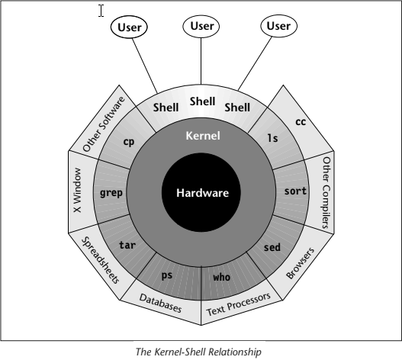
UNIX Architecture: The Kernel
Program always resides in memory
Has direct access to the hardware
Handles file I/O
Manages processes
Only one copy shared by all users

Slide 7
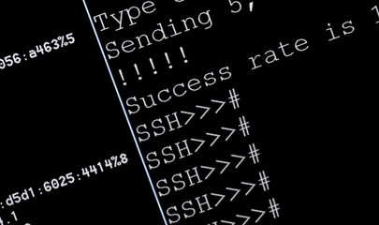
Some Common Shells
sh - The Bourne shell, first shell, fastest shell, best scripting shell
csh - The C shell, written by Bill Joy, usable, has neat features.
tcsh - The T shell, descended from csh, also written by Joy, Mac OS X standard.
ksh - The Korn shell, great shell not standard.
bash - Bourne again shell, Linux standard.

Slide 8
Key Concepts
Everything in the system is represented as a file
Work gets done by processes
Workload is shared by two separate programs (kernel and shell)
Kernel uses system calls to do most of the work
All UNIX systems use the same system calls
Not necessarily implemented the same

Slide 9
System Calls
Kernel, shell were written in C
Over a 1000 different commands in the system
Code for performing disk I/O operations is not built into the programs but is available in the kernel
Programs access kernel services by invoking special functions called system calls
Often, same system call can access both a file and a device
The open() system call opens both

Slide 10
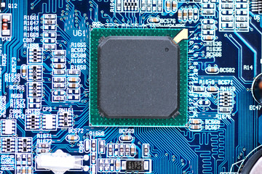
Multiuser / Multiprocessing
Building-block approach
Building larger from smaller; combining commands to accomplish a task
Very sophisticated pattern matching capabilities
The *.* in Windows came from UNIX

Slide 11
A BRIEF history of Unix
First came Multics (Multiplexed Information and Control Service) 1964
Bell Labs, General Electric, MIT started the project
Bell Labs left the project in 1968
Ken Thompson and Brian Ritchie started Unix in 1968
Ritchie was also one of the creators of the C programming language
In early days, AT&T gave away Unix to universities and colleges
This is where BSD (Berkeley Software Distribution) came from – free open source version of Unix
Mac OS is based upon BSD UNIX (Darwin)
SunOS was based upon BSD UNIX while Solaris was their licensed version of UNIX

Slide 12
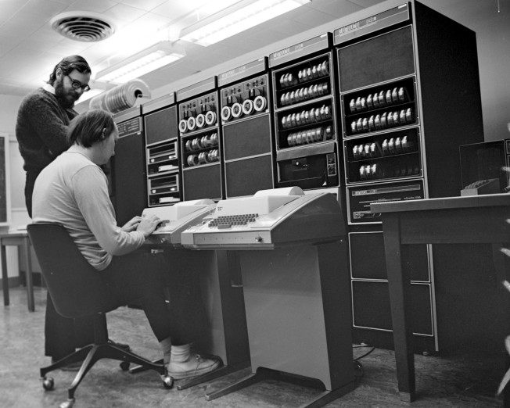
Thompson, Ritchie with PDP-11
Dennis Ritchie (right) and Ken Thompson (left)

Slide 13

A clip about Unix History

Slide 14
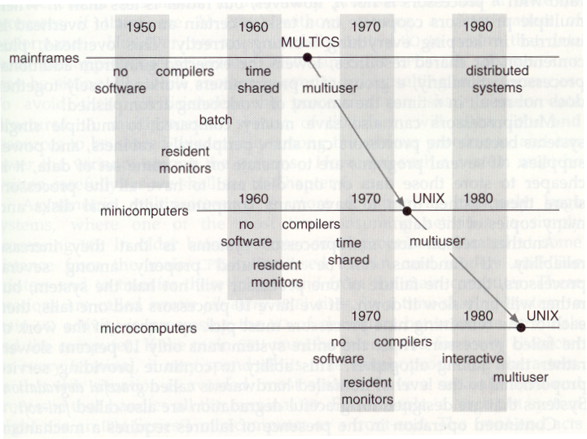
Evolution of Modern Computing

Slide 15
UNIX Architecture
The ‘kernel’ and the ‘shell’
Shell is also a programming language
‘files’ and ‘processes’
Files have places and processes have life
Files are containers for storing static information – directories and devices are considered files
Processes represent a programs in execution

Slide 16
UNIX Architecture: The Shell
A program or command invoked only when the user logs in
Accepts user input, examines and rebuilds the command line
Makes calls to the kernel for all other functions
At least one shell is invoked by every user
User has a choice of shells (Born, Korn, Bash, etc.)
Also a programming language

Slide 17
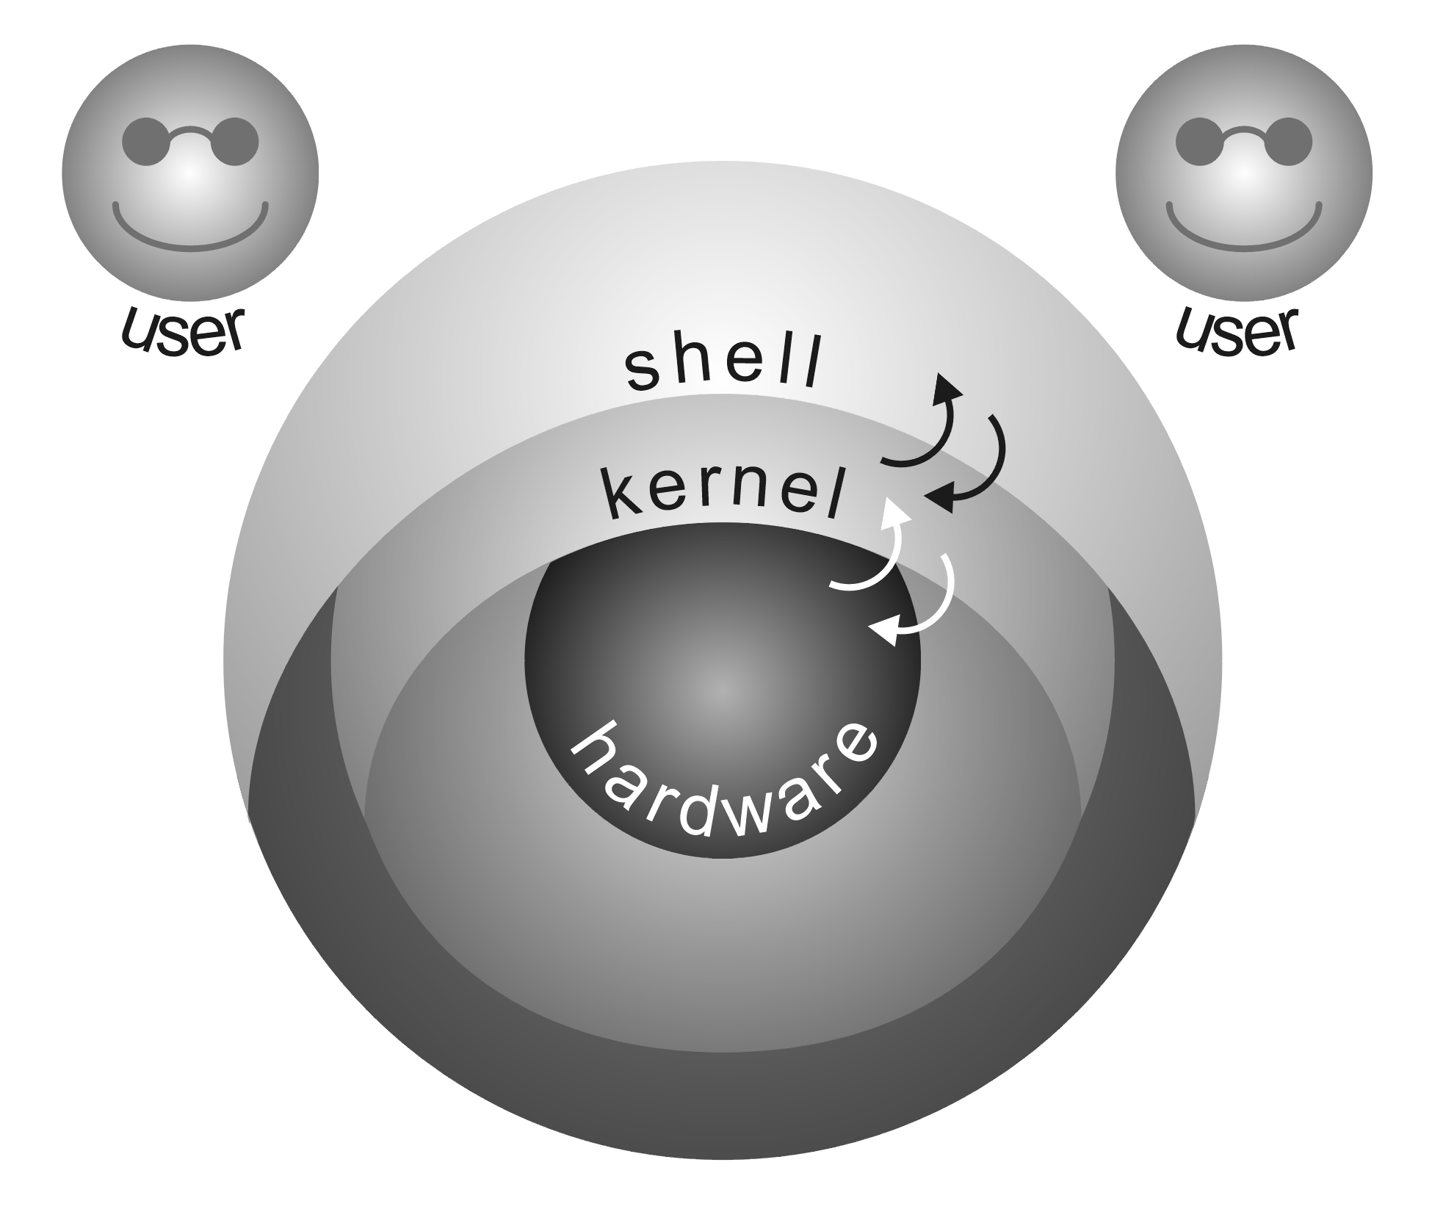
The Unix Onion
The user talks to the shell
The shell talks to the kernel
The kernel talks to the hardware (it is hardware specific)
The hardware does the work

Slide 18
History of Linux
Underlying GNU (GNU, Not Unix) Project was started by Richard Stallman in 1983 to create a free Unix-compatible operating system called GNU
Linus Torvalds, a graduate student at the University of Helsinki in Finland invented Linux in 1991 as a personal project that was based upon GNU
Developed kernel (Linux)
Incorporated many of the tools developed for GNU
Released under the GNU General Public License (GPL)
Red Hat, a major Linux distribution MUST provide a free version in accordance with the GPL – called Fedora and currently at version 27
Every major Linux distribution MUST provide a free version!
Linux is UNIX-like but not a registered UNIX version

Slide 19

Linux Distributions - Debian
Debian GNU
Non-commercial distribution started in 1993 & continues to be a popular distribution with many volunteer developers around the world
Base Debian system allows you to install & upgrade Debian packages easily with a package installer called apt-get (where apt = Advanced Package Tool)
Basis for several other recent distributions including Knoppix, MEPIS, Ubuntu, & Xandros
Download at www.debian.org

Slide 20

Linux Distribution - Fedora
This distribution, once known as Fedora Core, is the successor to Red Hat Linux – the Linux distribution from Red Hat
Fedora Core 1, released in Nov. 2003, was the successor to the Red Hat Linux 9
The current version is Fedora 27, released in November 2017
Fedora uses the Red Hat Package Manager (RPM) format for its software packages
Download at http://getfedora.org

Slide 21

Linux Distribution - Gentoo
Non-commercial, source-based (all software is provided in source code form) that first appeared in 2002
The installer provides some binary packages to get the Linux going, but the idea is to compile all source packages on the user's computer
It is time consuming to build a full-fledged Gentoo system with the latest graphical desktops, multimedia, and development tools as all packages have to be downloaded and compiled
Download at www.gentoo.org

Slide 22

Linux Distribution - Slackware
One of the oldest distributions, having been first released in 1992
Uses compresseda ‘tar’ files for its packages and provides a text-based installer with limited automatic detection of hardware
All software configuration is done by editing text files
Download at www.slackware.com

Slide 23

Linux Distribution - SUSE
This is both a commercial and non-commercial distribution with openSUSE being released in 2005
Commercial version is called SUSE Linux Enterprise Server (SLES)
SUSE Linux Open Source Software (OSS) is freely available, and the retail SUSE Linux is based on the open source version
It comes with the YaST installation and configuration tool, which is one of the best administration tools available
The openSUSE project provides the ISO image files from various mirror sites at https://software.opensuse.org/

Slide 24

Linux Distribution - Ubuntu
A Debian-based, non-commercial Linux distribution that has become very popular since its initial release in 2004
Available as both an install CD and a Live CD
Because it's Debian-based, you can install the basic desktop system from the install CD and then use the apt-get (Advanced Package Tool) to install other packages as well as to keep the system up to date
Download at www.ubuntu.com/download

Slide 25
Linux Kernel Stable Version Numbers
After Linux kernel version 1.0 was released on March 14, 1994, the loosely knit Linux development community adopted a version-numbering scheme
Versions such as 1.x.y & 2.x.y, where x is an even number, are considered stable
The last number, y, is the patch level, which is incremented as problems are fixed
For example, 4.14.8 is a typical, stable version of the Linux kernel (and the current version released 12/20/17)
Version numbers are in the form of integers separated by periods – Major, Minor, Patch

Slide 26
Distribution-Specific Version Numbers
Each Linux distribution has a version number as well
These version numbers usually follow the format x.y, where x is the major version, and y is the minor version
Unlike the Linux kernel version numbers, no special meaning is associated with odd- and even-numbered minor versions
Each version of a Linux distribution includes specific versions of the Linux kernel and other major components, such as GNOME, KDE, and various applications

Slide 27

The UNIX philosophy
Small is Beautiful
Each program does one thing well
Prototype ASAP
Portability over efficiency
Data as flat ASCII files
Use software leverage
Build shell scripts not programs
Avoid captive user interfaces
Make all programs filters

Slide 28

Myths about UNIX
Unix is hard to learn… not compared to particle physics!
Unix commands are terse… actually they are efficient!
Unix is only for Geeks… and anyone else who doesn’t want to reboot daily!
Unix is not friendly… it is friendly, just picky about choosing its friends

Slide 29

Realities about UNIX
Unix is the most powerful, stable, mature OS available
Unix considers you a cognizant adult
Unix is pretty much Unix across flavors
Unix can be a great deal of fun to use!

Slide 30

A Few Thoughts about UNIX
You really don’t need a GUI…really!
Unix folks are special, they share and support one another
Unix is mature and it is stable
You are joining a unique community
Welcome!

Slide 31
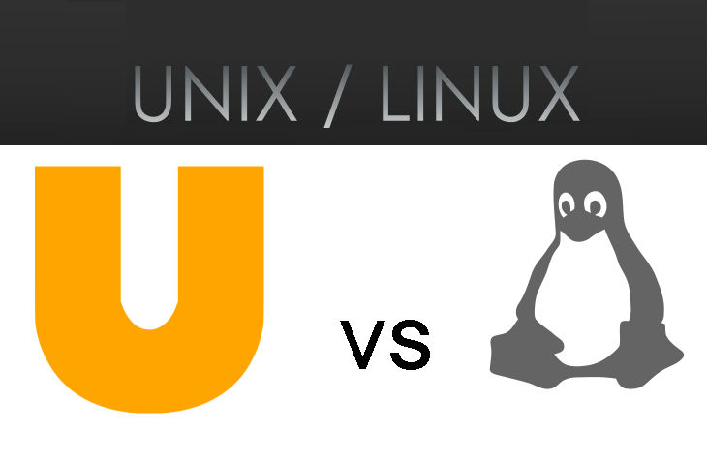
Differences between UNIX’ and Linux
The main differences between each of the main UNIX OS’ (IBM AIX, HP/UX, and Oracle Solaris) is:
How they implement virtualization
How they address hardware enhancements
How they view open source
IBM and Sun (bought by Oracle) both gave much to the open source community as Free Open Source Software (FOSS)
The fundamental commands/programs are the same (or similar) in each version of UNIX and in Linux
Linux is not hardware bound but generally runs on Intel x86 hardware
Linux supported by developers around the globe
Version 1 released in 1994
Linux was written from scratch; is not a UNIX derivative

Slide 32
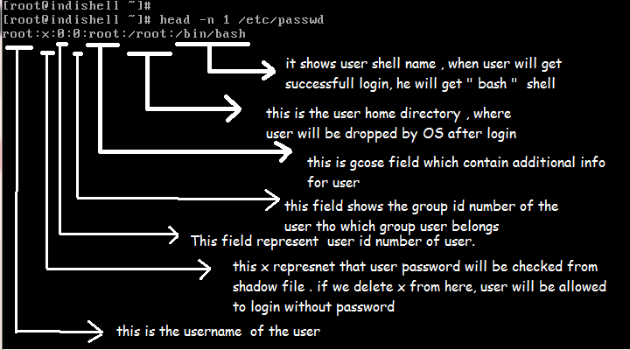
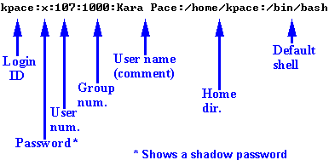
The Structure of /etc/passwd
You should memorize the 7 fields in /etc/passwd
This file is critical for many Unix tasks
It is the file consulted for login, to apply file permissions, etc.

Slide 33
File matching metacharacters
Metacharacters expand to many other possible characters
Can make you more efficient and effective
Are expanded by the shell
Standard metacharacters:
* matches zero or more of any character
? matches exactly one character
[abc] matches one of the range a, b, or c
[^abc] matches any one character except a, b, c
[9-1] is a backward range, will cause unpredictable results, (Bad)

Slide 34
Recording LABS
Before you being working on a LAB, type ‘script labx’ where x is the lab number; example lab1, lab2, etc.
When you are finished with the lab, type ‘exit’
After recording is complete, run ‘fixscript’
fixscript is located in Learning Materials
‘fixscript labx lab_x_student_name
fixscript is necessary to make the file readable in editors

Slide 35
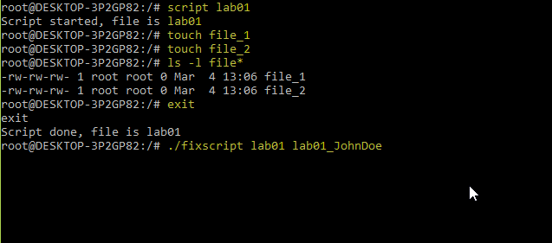
Recording LABS (Cont.)

